Slide 1
Topic: General Muhammad Ayub Khan
Miss Bushra Jabeen
Kinnaird college

Slide 2
CONTENTS
Early years and personal life
Military career
Commander-in-Chief
Defense Minister
President of Pakistan (1958–1969)
Move to Presidential republic
Legitimization Under the Doctrine of Necessity
Devices Applied to Perpetuate the Rule
Selective Co-option
Containment
Collateralization
Economic Policies
Industrial Growth
Agricultural Growth
New Economic Class
Legacy
Foreign policy
The Crisis
The Abdication
Death

Slide 3
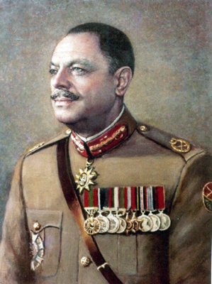
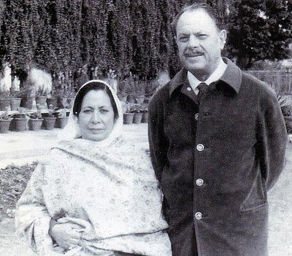
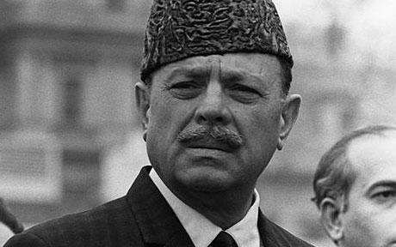
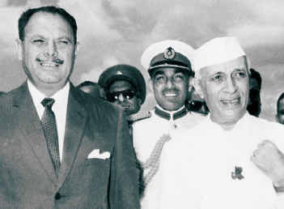
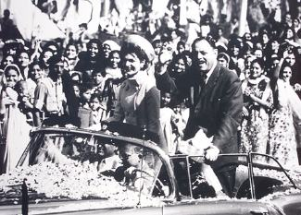
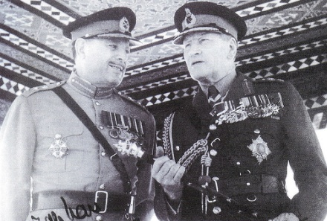
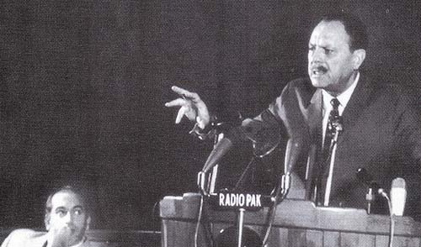
General Muhammad Ayub Khan

Slide 4
Early years and personal life
Ayub Khan was born on 14 May 1907, in Haripur British India, in the village of Rehana in the Haripur District in the Hazara region of the North-West Frontier Province (now Khyber-Pakhtunkhwa).
He was ethnically a Pashtun (or Pathan) of the Tareen tribe, although a Hindko speaker. He was the first child of the second wife of Mir Dad Khan Tareen, who was a Risaldar-Major (senior regimental non-commissioned officer) in Hodson's Horse, a cavalry regiment of the pre-independence Indian Army.
For his basic education, Ayub was enrolled in a school in Sarai Saleh, which was about four miles from his village and he commuted to school on a mule's back.
Later he was moved to a school in Haripur, where lived with his grandmother. He enrolled at Aligarh Muslim University in 1922, but did not complete his studies there, as he was accepted into the Royal Military Academy Sandhurst.

Slide 5
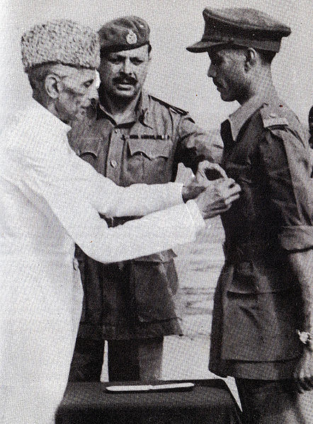
Military career
Ayub Khan did well at Sandhurst and was
given a commission as Second Lieutenant in
the Indian Armyon 2 February 1928 and then
joined the 1st Battalion of the 14th Punjab
Regiment Sherdils, later known as 5th Punjab
Regiment.
He was promoted to Lieutenant in 1932; a
Captain in 1936 and Major in 1940.
During the Second World War, he was
promoted as a Lieutenant-Colonel in 1942
and was significantly drafted in British Army
to participate on 1942 Burma front.
He commanded the 1st Battalion, 14th
Punjab Regiment as its Commanding officer.
In 1945, he was promoted to Colonel and
assumed the command of his regiment to
direct operations on 1945 Burma campaign.

Slide 6
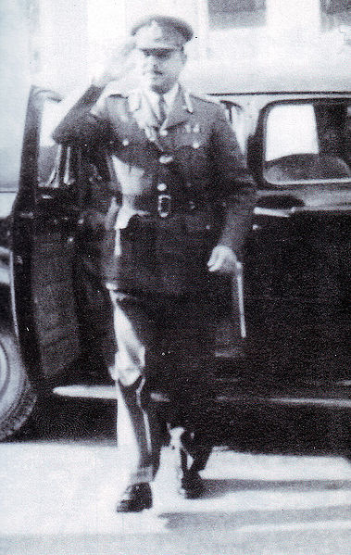
Commander-in-Chief
Defense Secretary Iskandar Mirza
played an instrumental role in
Ayub's promotion, and convinced
Prime minister Ali Khan to appoint
Ayub Khan to four-star rank.
His papers of promotion were approved
and Ayub Khan landed a four-star
appointment on January 17, 1951.
With Ayub becoming the chief
of staff, it marked the indigenization
of the military and ending the
transitional role of British Army officers.

Slide 7
Ayub Khan as Defence Minister
He would later go on to serve in the second cabinet (1954) of Muhammad Ali Bogra as Defence Minister, and when Iskander Mirza declared martial law on 7 October 1958, Ayub Khan was made its chief martial law administrator.
Azam Khan (general), Nawab Amir Mohammad Khan and Sandhurst trained General Wajid Ali Khan Burki were instrumental in Ayub Khan's Rise to power.
This would be the first of many instances in the history of Pakistan of the military becoming directly involved in politics.

Slide 8
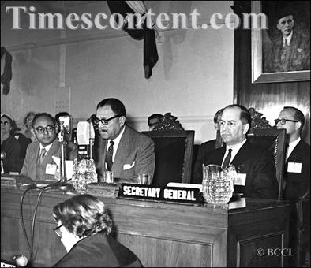
President of Pakistan (1958–1969)

Slide 9
President of Pakistan (1958–1969)
After the collapse of the Cabinet of I I Chundrigar, Feroz Khan Noon formed the Cabinet with the support of Republican Party, Awani Party and Krishk Sramik Party, Iskandar Mirza was bit distressed by this alliance, because in next general elections Suhrawardy and Noon were dreaming about becoming Prime Minister and President respectively.
On the other side, in West Pakistan Muslim League had become very popular due to leadership of Khan Abdul Qayyum Khan. These events were against Iskandar Mirza hence he was willing to dissolve even Pakistan's one unit for his advantage.
Hence he declared Martial Law on midnight of 7 and 8 October 1958 abrogating the 1956 constitution, Ministers were dismissed, Central and Provincial governments and assemblies were dissolved and he appointed C-in-C (Commander in Chief) General Ayub khan to lead the country with him.
Similarly, as a result of his having control of the Pakistan Army, Ayub deposed Mirza on 27 October in a bloodless coup, sending Generals Wajid Burki, Azam, and Sheikh in the middle of the night to pack Mirza off to exile in England.
This was actually welcomed in Pakistan, since the nation had experienced a very unstable political climate since independence.
In 1960, he held an indirect referendum of his term in power. Functioning as a kind of electoral college, close to 80,000 recently elected village councilmen were allowed to vote yes or no to the question: "Have you confidence in the President, Field Marshal Mohammed Ayub Khan?" Winning 95.6% of the vote, he used the confirmation as impetus to formalise his new system.

Slide 10
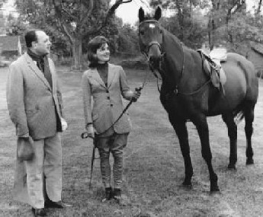
Move to Presidential republic
Ayub moved to have a constitution
created, and this was completed in
1961.
A fairly secular person by nature,
Ayub Khan's constitution reflected his
personal views of politicians and the
use of religion in politics.
In 1962, he pushed through a new constitution
that while it did give due respect to Islam, it did
not declare Islam the state religion of the country. It also provided for election of the President by 80,000 (later raised to 120,000) Basic Democrats—men who could theoretically make their own choice but who were essentially under his control.
He justified this as analogous to the Electoral College in the United States and cited Thomas Jefferson as his inspiration.
The government "guided" the press though his take over of key opposition papers and, while Ayub permitted a National Assembly, it had only limited powers.

Slide 11
Legitimization Under the Doctrine of Necessity
There was Legal Vacuum when military took over on 7th October 1958, under which a legal system the courts would operate. The president issued a new legal order titled Laws (Continuation in Force) Order on 10th October, 1958 which provided for:
Validation of laws in force before the declaration of Martial law.
Restoration of jurisdiction of courts and
Governance as nearly as possible in accordance with 1956 constitution.

Slide 12
The above mentioned Law Order was called into question
The above mentioned Law Order was called into question before the supreme court in a case called Dosso case, already pending even before the imposition of martial law.
Chief Justice Muneer of the Supreme Court was keen to appease his new masters and in haste to legitimize the imposition of Martial.
He treated the “coup d’etat” (violent or subversive take-over of state affairs) as a revolution, wrongly though, like the French Revolution or Soviet Revolution.

Slide 13
Chief Justice Muneer justified the imposition of martial law on the following grounds.
That a where a revolution is successful, it satisfies the test of efficacy and becomes a law creating fact.
That the writ if issued would not have been enforceable.
That the common law of state from dissolution. This means preservation of state becomes overriding consideration or higher purpose than the law of land in situations of national disaster, war, extreme anarchy, and such like conditions.

Slide 14
Devices Applied to Perpetuate the Rule
Changes in the political structure becomes inevitable. The purpose is to bring the balance of power in favor of military. Ayub Khan not only made drastic structural changes but also mechanism or devIces to achieve this purpose.
In order to Perpetuate his rule which became a standard practice for successive regimes, was based upon the following:
Selective Co-option
Containment
Collateralization
Economic Policies

Slide 15
Selective Co-option: (to associate, choose pr persuade for cooperation and sharing responsibility)
The selective Co-option policy was intended to bring into government fold those conservative land loads and middle farmers who were willing to cooperate and socialize in subordination to the administrative rulers.
In order to slash the role of former political elite and to level the ground for selective co-option, the regime took two steps.
First, the regime enforced a law called Elective Bodies (Disqualification) Order (EBDO) in 1959. About 6000 politicians of various size and shades were debarred from holding any elective office till 31st Dec. 1966.
Second, a new system of local bodies called the basic Democratic (BD) System was introduced by an order on 27th Oct. 1959. Those who were consistent in showing loyalty towards the government were selectively co-opted at different levels of local self-government.

Slide 16
Containment: (to keep in limit or discipline, to nip the opposing party in bud)
The masses, the former elite and the religious elites had to be contained or kept in limits.
The previous civilian government had been penetrated by the religious elites to legitimize their role in the political system. The military, however, considered them peripheral to the coalition. They did agitate and protest but were contained by the military with the help of bureaucracy.
The regime de-politicized the masses by banning political parties and political activities. The political cleansing of the system was considered essential. It was done by treating political activity as anti-state and by containing it.
Land reforms served purpose of containment. The upper limit of land owning being 500 acres of irrigated and 1000 acres of non irrigated land despite its half-heated implementation, rendered some land to landless farmers.
The fear of more reforms kept a hanging sword of the heads of feudal aristocracy and they remained docile to the new regime.

Slide 17
Collateralization
It refers to sharing in subordinate positions and not as equal partners in power structure.
Collaborate or serve as supplementary partner.
It is like step-brother having a rapport but not an absolute position like other brothers from the same father but from a different mother.
This martial law regime of Ayub Khan socialized the bureaucracy to descend from c0-equal to collateral relationship.
An order was passed in 1959 for thorough cleansing of corrupt government servants. The process of close scrutiny initiated Ayub led to the removal of about 3000 government servants including 138 senior officers.
Also many military officers were inducted in the civil service.
The bureaucracy after some resistance acquiesced. The collateralization enhanced effective control of the regime and prolongation of its life.

Slide 18
Economic policies
There was no organized class of merchants, traders, or industrialists, of even small scale at the time of Pakistan’s creation.
The trader-merchants class comprising of minority Muslim communities such as bohras, khojas, memons in Karachi and saigals and chinioty shaikhs in Punjab were dynamic and skillful entrepreneurs.
As business community, they were quick to seek bureaucratic patronage from the Ayub Khan’s regime and soon came to dominate the commercial and industrial life.
The chambers of commerce came into existence. The vacuum created by migrant hindus were filled. The trader-merchant class was converted into financial-industrial class.
By indentifying itself with United States the regime was able to receive capital and foreign exchange flow.
The regime increased the credit facility which led to fostering of industrial growth.
U.S expertise came in for development of economic institutions.
The Harvard Advisory Group (HAG) began operations and played a key role in planning, promoting, and expanding economic institutions.

Slide 19
Industrial Growth
Fostering of economic institutions and planning of economy was initiated.
Planning commission was set up and it organized long-term, 5 years development plans The Planning Commission not only trained the professionals but also provided the intellectual and administrative leadership.
Industrialization grew.
The Pakistan Industrial Development Bank (PIDC) set up several industries such as Jute, Textile, Sugar, Fertilizers, Paper board, ship building.
Some of the industrial project were transferred to private sector.

Slide 20
Agricultural Growth
An Agricultural development Bank Of Pakistan (ADBP), set up by the government, provided liberal loans for the purchase of tractors, installation of tube-wells and purchase of fertilizers.
There occurred a green revolution and agriculture production boomed.
The village Aid Program under US economic assistance improved irrigation facilities.

Slide 21
New Economic Class
The regime recruited new members to the industrial commercial classes to undermine the established industrial-merchants classes.
A scheme was introduced as commercial policy which led to change the structure of merchant-industrial class.
It was called Bonus Vouchers Scheme (BVS). The scheme allowed exporters to receive vouchers priced at a certain properties of the values of goods and commodities they sold abroad.
The BVS were bought by the importers to obtain foreign exchange and import consumer goods. This served as a tool for distributing economic benefits from one class to another.
Thus a new merchant commercial class was inducted into the economic system which was sympathetic to ruling coalition.
The basic thrust of the regime was on economic was on development.
The third five years plan (1965-70) generated tremendous growth but it also increased economic inequality. The famous 22 families dominated. The crises of unequal growth produced political crises Urbanization accelerated with attached social problems.

Slide 22
No Viable Political Institution
Yet the rate of development of political institutions remained extremely low.
The regime made no effort to develop viable political institution that will give the urban proletariat and industrial labour a sense of political participation.
By mid sixties the ruling coalition was confident of its durability.
It conceded limited political participation by letting the National assembly elected through an indirect election by members of the local councils in 1965.
General Ayub got himself elected as President, through the same electoral collage.

Slide 23
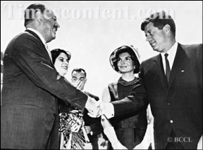
Foreign policy
Ayub Khan closely allied with the United States and his allies while publicly criticized the Soviet Union.
His first visit to United States took place as he was the Defence Minister as part of the delegation of Prime minister Liaquat Ali Khan, convincing the U.S with along with prime minister to provide a military aide to the country.
The new defence minister Ayub Khan was obsessed with modernization of the armed forces in shortest possible time saw the relationship with United States the only way to achieve his organizational and personal objectives.

Slide 24
The crisis
The political participations in the late 1960's, limited though, mobilized the mass eventually.
The EBDO period had come to an end by 31st December 1966. The regime's economic policies came under attack.
The change in external environment occurred when Pakistan, despite being member of Western Pacts, began to cultivate relations with the communist Countries particularly, Chine. Bhutto pushed for closer ties with China and a border agreement was signed in 1963.
Pakistan sought aid from China an alternative source. America terminated aid to Pakistan during 1965 war with India.
The bad harvest and slackened economic growth had adverse effects.
The crisis of the system further aggravated and the politics of protest reached a turning point.
By 1968-69 he students, the intelligentsia, middle class, anti-regime political elites had mounted the agitations against the quasi-authoritarian rule of Ayub Khan.
There was internal bickering and disintegration within the ruling elite appeared as well.
The foreign minister Z.A Bhutto had quit the government and formed his own separate party PPP.

Slide 25
The Abdication
Ayub Khan abdicated power to the Military and Martial Law was again imposed in March 1969.
Unlike the 1958 military intervention which was seen as restoring political order, the 1969 martial law was perceived as an act of vested interest to forestall the revolution.
Instead of handing over the power to the speaker of National Assembly (Fazal-ul-Haq Chaudry, an East Pakistani) as per the 1962 constitution, Ayub Khan in order to escape accountability preferred another military ruler for Pakistan.
Yahya Khan's rule for 2 years remained under crises. Selective co-option of religious elite did not work.
Elections altogether changed the capacity of government to have any strong coalition base.
The external environment, the 1971 war and the resultant dismemberment of Pakistan with the creation of BANGLADESH brought a collapse of the regime.
The taste of the rejuvenating the system in new Pakistan was left to next regime.

Slide 26
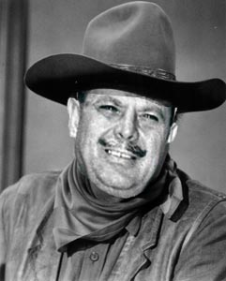
Death
In 1971 when war broke out, Ayub Khan was in West Pakistan.
He presented himself for fighting in war but government turned him down on account of his age and ill-health.
He did not comment on the events of the war.
He died in 1974.

Slide 27
Resources
Notes Provided by Miss Bushra
http://en.wikipedia.org/wiki/Ayub_Khan_(Field_Marshal)
http://storyofpakistan.com/muhammad-ayub-khan/
http://www.timescontent.com/tss/showcase/preview-buy/14278/News/Mohammad-Ayub-Khan.html
https://www.google.com/search?hl=en&q=general+mohammad+Ayyub+khan+president+of+pakistan&bav=on.2,or.r_gc.r_pw.r_qf.,cf.osb&biw=1163&bih=574&um=1&ie=UTF-8&tbm=isch&source=og&sa=N&tab=wi&ei=tCb7T63KL4nV4QTCsLSGBw#q=Move+to+Presidential+republic+general+ayub+khan&um=1&hl=en&tbm=isch&fp=1&biw=1163&bih=574&bav=on.2,or.r_gc.r_pw.r_qf.,cf.osb&cad=b&sei=tDT7T4OBMMGg4gSkkMD9Bg
http://www8.open.ac.uk/researchprojects/makingbritain/content/muhammad-ayub-khan
http://www.britannica.com/EBchecked/topic/46617/Mohammad-Ayub-Khan
http://www.pakistanpaedia.com/hist/pak_years/pak_hist2.htm

